Slide 1
Chap11 & Lab6: Hadoop Implementation
National Tsing Hua University
2019, Fall Semester

Slide 2
Outline
Basic Hadoop Programming
Hadoop Classes
Mapper/Reducer
WordCount Example
Hands-on Lab
HDFS/ MapReduce
Hive / Spark
Advanced Hadoop Programming
Custom key & value types
Combiner/Partitioner
GroupingComparator/SortComparator
Secondarysort example

Slide 3
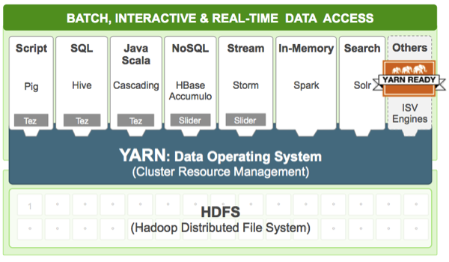
Hadoop Implementation
Hadoop release 2.x
New version with YARN (resource manager)
Latest version is 2.8.2 (Oct. 2017)
Java Language
Based on inheritance and interface
Official Tutorial
https://hadoop.apache.org/docs/current/hadoop-mapreduce-client/hadoop-mapreduce-client-core/MapReduceTutorial.html

Slide 4



Hadoop Runtime
Hadoop
Queue
JOB
JOB
JOB
JOB
JOB
JOB
MapReduce on Server Farm

Slide 5
Import hadoop package
Import classes in “org.apache.hadoop.mapreduce” package
import java.io.IOException; import java.util.StringTokenizer;
import org.apache.hadoop.conf.Configuration;
import org.apache.hadoop.fs.Path;
import org.apache.hadoop.io.IntWritable;
import org.apache.hadoop.io.Text;
import org.apache.hadoop.mapreduce.Job;
import org.apache.hadoop.mapreduce.Mapper;
import org.apache.hadoop.mapreduce.Reducer;
import org.apache.hadoop.mapreduce.lib.input.FileInputFormat;
Import org.apache.hadoop.mapreduce.lib.output.FileOutputFormat;
[Other necessary classes called by your code ……]
Notice:
“mapreduce” package it not interchangable with “mapred” package
Prevent using “Deprecated” methods

Slide 6
Main Hadoop Classes
Configureation
Hadoop cluster configuration
Job
the primary interface for a user to describe a map-reduce job to the Hadoop framework for execution
Mapper
maps input <K,V> pairs to intermediate <K,V> pairs
Reducer
reduces intermediate values to a smaller set of values
Partitioner
partitions the key of intermediate <K,V> pairs to reducer
Combiner
combine map-outputs <K,V> pairs before being sent to reducers
RecordReader/RecordWriter
Read input file & write output file

Slide 7
Job Class
configure a job
Specify the class for mapper, reducer, combiner, etc.
submit the job
Submit the job to the cluster and return immediately
Or submit the job to the cluster and wait for it to finish
control its execution
Set the number of max attempts to run a reduce or map task.
Set scheduling priority.
Kill the running job, or specific task.
Turn speculative execution on or off for this job.
query its state.
Get the progress of the job's map-tasks or reduce-tasks (between 0 and 1).
Returns the current state of the Job.
Get start time of the job.
Check if the job completed successfully.

Slide 8
Job Creation & Submission
Method | Description
getInstance (Configuration conf, String jobName) | Creates a new job with a given jobName.
setJarByClass(Class<?> cls) | Set the Jar by finding where a given class came from.
submit() | Submit the job to the cluster and return immediately. (non-blocking call)
waitForCompletion(boolean verbose) | Submit the job to the cluster and wait for it to finish. (blocking call)
main()
main()
submit()
waitFor
Completion()
Job
Job
tasks
tasks
blocked
Query job status
Control execution
Get execution results
exit()
exit()

Slide 9
Query & Control Job Execution
Method | Description
getStartTime() | Get start time of the job.
getFinishTime() | Get finish time of the job.
getStatus() | Returns a JobStatus object contain all the current job state info
mapProgress() reduceProgress() | Get the progress of the job. , as a float between 0.0 and 1.0.
getCounters() | Gets the counters object for this job
isComplete() | Check if the job is finished or not.
Method | Description
setPriority(JobPriority prio) | High/Low/Normal/Very_High/Very_Low
setNumReduceTasks(int n) | Set the requisite number of reduce tasks for this job. (notice: no method for map tasks)
setSpeculativeExecution(boolean flag) | Turn speculative execution on or off for this job.
killJob() | Kill the running job.
killTask(TaskAttemptID taskId) | Kill indicated task attempt.

Slide 10
Example
public class WordCount {
public static void main(String[] args) throws Exception {
Configuration conf = new Configuration();
Job job = Job.getInstance(conf, “wordcount”);
job.setJarByClass(WordCount.class);
job.waitForCompletion(true); // Submit the job and wait for it to finish
}
}
public class WordCount {
public static void main(String[] args) throws Exception {
Configuration conf = new Configuration();
Job job = Job.getInstance(conf, “wordcount”);
job.setJarByClass(WordCount.class);
job.submit(); // Submit the job and return immediately
while(job. isComplete()==false) {
System.out.println(mapProgress());
}
}
}

Slide 11
Job Configuration on Compute Functions
Method | Description
setMapperClass (Class<? extends Mapper>) | Set the Mapper class for the job
setReducerClass (Class<? extends Reducer>) | Set the Reducer class for the job.
setPartitionerClass (Class<? extends Partitioner>) | partition Mapper-outputs to be sent to the reducers
setCombinerClass (Class<? extends Reducer>) | combine map-outputs before being sent to the reducer It is an optional function during execution
setGroupingComparatorClass (Class<? extends RawComparator>) | Define the comparator that controls which keys are grouped together for a single call to reducer
setSortComparatorClass (Class<? extends RawComparator>) | Define the comparator that controls how the keys are sorted before they are passed to the reducer
Notes:
What has default
What has to be defined?

Slide 12
Map Phase Steps
Input fie
on HDFS
Local Memory/Buffer on each Mapper
Temp file
on local disk
optional
dog cat dog deer
dog,1 cat ,1
dog ,1
deer,1
cat ,1
dog,1 dog ,1
dog cat dog deer pig bear
dog pig bear cat dog egg
cat ,1
dog,2
cat ,1
dog,2
deer,1
deer,1
deer,1
pig bear
dog pig
pig,1 bear,1
dog,1
pig,1
bear,1
dog,1
bear,1
dog,1
bear,1
dog,1
pig,1
pig,1
pig,2
pig,2
bear cat dog egg
bear,1 cat,1
dog,1
egg,1
bear,1 cat,1
dog,1
bear,1 cat,1
dog,1
bear,1 cat,1
dog,1
egg,1
egg,1
egg,1
split (inputformat)
map (mapper)
partition
(partitioner)
Combine
(combiner)
store

Slide 13
Reduce Phase Steps
Temp file Mapper’s
local disk
Local Memory/Buffer on each Reducer
Output files
on HDFS
cat ,1
dog,2
cat ,1
dog,2
bear,1
bear,1 cat,1
cat,1
dog,1
dog,2
dog,1
deer,1
bear,1
dog,1
bear,<1,1>
cat,<1,1>
dog,<1,2,1>
bear,2
cat,2
dog,4
bear,2
cat,2
dog,4
bear,1
dog,1
bear,1 cat,1
dog,1
pig,2
bear,1 cat,1
dog,1
deer,1
deer,1
egg,1
pig,2
deer,<1>
egg,<1>
pig,<2>
deer,1
egg,1
pig,2
deer,1
egg,1
pig,2
pig,2
egg,1
egg,1
mergesort
(sortComparator)
group
(groupingComparator)
reduce
(reducer)
write
(outputformat)
fetch&shuffle

Slide 14
Job Configuration on Data Type
Method | Description
setInputFormatClass() | Set the InputFormat implementation for the job
setMapOutputKeyClass() | Set the key class for the map output data Same type as final output if not specify
setMapOutputValueClass() | Set the value class for the map output data Same type as final output if not specify
setOutputKeyClass() | Set the key class for the job output data
setOutputValueClass() | Set the value class for job outputs
setOutputFormatClass() | Set the OutputFormat implementation for the job
Initial <K,V>
Inter.
<K,V>
final
<K,V>
Input File
bytes
Record
Reader
Mapper
Reducer
Record
Writer
bytes
Output File
inputsplit
MapOuput <K,V> class
Output <K,V> class
Input Format Imp.
Output Format Imp.

Slide 15
How many Map/Reduce Tasks?
The number of map tasks is controlled by the implementation of inputsplit in inputFormat
Default is to split by the block size of files in HDFS
But it can also be overwritten to split differently
The number of reduce tasks is controlled by the job configuration: job.setNumReduceTasks(int n)
The right number of reduces seems to be 0.95 or 1.75 multiplied by #reduce_slots
More reducer ➔ higher framework overhead, better load balancing and lowers failure cost.

Slide 16
Input/Output Format Class
The MapReduce operates exclusively on <K, V> pairs
It views the job input as a set of <key, value> pairs and produces a set of <key, value> pairs as the output of the job
InputFormat: parse input file into a set of <key, value>
TextInputFormat: Keys are the position in the file, and values are the line of text.
KeyValueTextInputFormat: Each line is divided into key and value parts by a separator byte. If no such a byte exists, the key will be the entire line and value will be empty.
OutputFormat: write a set of <key, value> to output file
TextOutputFormat: writes plain text: key, value, and "\r\n".

Slide 17
Key-Value Pair Class
Both key and value must implement Writiable interface
A serializable object which implements a simple, efficient, serialization protocol, based on DataInput and DataOutput
Key also implements the interface of WritableComparable
Because key must be sorted by the framework
Default supported types includes:
BooleanWritable, BytesWritable, DoubleWritable, FloatWritable, IntWritable, LongWritable, Text, NullWritable

Slide 18
WordCount: Main()
public static void main(String[] args) throws Exception {
Configuration conf = new Configuration();
Job job = Job.getInstance(conf, “world count”);
job.setJarByClass(WordCount.class);
job.setMapperClass(Tokenizer.class); // Tokennizer is the mapper function
job.setCombiner(IntSum.class);
job.setReducerClass(IntSum.class); // IntSum is the reducer function
//FileInputFormat is the base class for all file-based InputFormats
FileInputFormat.addInputPaths(job, new Path(args[0]));
FileOutputFormat.addOutputPath(job, new Path(args[1]));
job.setInputFormat(TextInputFormat.class); // inputs are texts
job.setOutputFormat(TextOutputFormat.class); // outputs are texts
job.setOutputKeyClass(Text.class); // intermediate and final key is text
job.setOutputValueClass(IntWritable.class); // intermediate and final value is int
job.waitForCompletion(true); // Submit the job and wait for it to finish
}

Slide 19
Mapper
Mapper maps input key/value pairs to a set of intermediate key/value pairs
The transformed intermediate records do NOT need to be the same type as the input records.
A given input pair may map to zero or many output pairs.
Each key/value pair is applied with a map function:
map(WritableComparable, Writable, Context)
<WritableComparable, Writable> are the input key-value pairs generated by the InputFormat class
context.write(K, V) collects output key-value pairs

Slide 20
Mapper
Input <K,V> type from InputFormat
Default <K,V> type for final output
public static class Tokenizer extends Mapper <Object, Text, Text, IntWritable> {
private final static IntWritable one = new IntWritable(1);
private Text word = new Text();
public void map(Object key, Text value, Context context)
throws IOException {
String line = value.toString();
StringTokenizer iter = new StringTokenizer(line);
while (iter.hasMoreTokens()) { // each line has multiple words
word.set(iter.nextToken());
context.write(word, one);
}
}
}
<K,V> must be private var to the class
Set the var value
Don’t declare a new var here
main():
job.setOutputKeyClass(Text.class);
job.setOutputValueClass(IntWritable.class);
job.setMapperClass(Tokenizer.class);
job.setInputFormat(TextInputFormat.class);

Slide 21
Reducer
Reducer reduces a set of intermediate values which share a key to a smaller set of values.
The transformed intermediate records do NOT need to be the same type as the input records.
A given input pair may map to zero or many output pairs.
Each group of (K,V) pair applied with a reduce func:
reduce(WritableComparable, Iterator<Writable>, Context)
WritableComparable is the input key-value pairs generated by the mapper class
Iterator<Writable> is the list of values grouped by the same key
context.write(K, V) collects output key-value pairs

Slide 22
Reducer
Output <K,V> type
public static class IntSum extends
Reducer<Text, IntWritable, Text, IntWritable>
{
private IntWritable result = new IntWritable();
public void reduce(Text key, Iterator<IntWritable> values,
Context context) throws IOException, InterruptedException
{
int sum = 0;
while (values.hasNext()) sum += values.next().get();
result.set(sum);
context.write(key, result);
}
}
Set the var value
Don’t declare a new var here
main():
job.setOutputKeyClass(Text.class);
job.setOutputValueClass(IntWritable.class);
job.setReducerClass(IntSum.class);
job.setOutputFormat(TextInputFormat.class);

Slide 23
Outline
Basic Hadoop Programming
Hadoop Classes
Mapper/Reducer
WordCount Example
Hands-on Lab
HDFS/ MapReduce
Hive / Spark
Advanced Hadoop Programming
Custom key & value types
Combiner/Partitioner
GroupingComparator/SortComparator
Secondarysort example

Slide 24
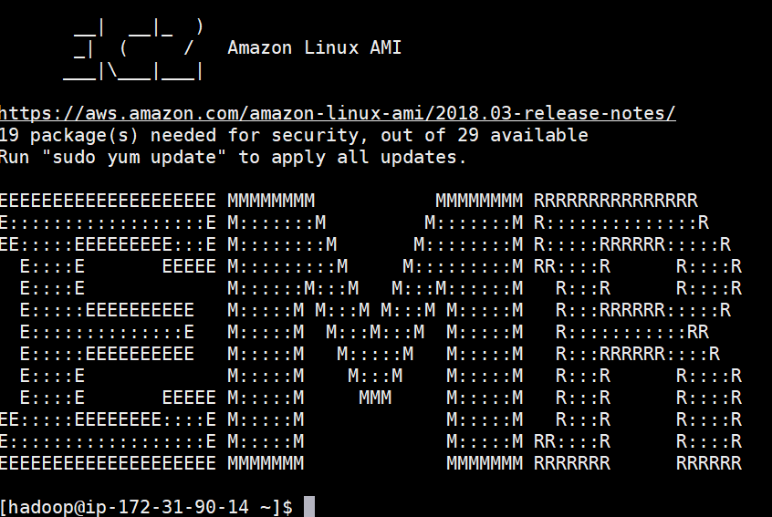
Hands-on Lab
SSH login to our Hadoop cluster
Access info has just sent to your ilms email

Slide 25
Basic HDFS Commands
Command | Description
-ls <args> | List directory
-mkdir <paths> | Create a directory
-put <localsrc> <HDFS_dest_Path> | Upload files
-get <hdfs_src> <localdst> | Download file
-cat <path[filename]> | See content of files
-cp <source> <dest> | Copy files in HDFS
-rm <arg> | Remove files or directories
-tail <path[filename]> | Display last few lines of a file
-getmerge [hdfs_src_dir] [hdfs_dst_file] | Merge files (from reducers)
$hadoop fs [command]
Ref: https://hadoop.apache.org/docs/r2.7.1/hadoop-project-dist/hadoop-common/FileSystemShell.html

Slide 26
Steps to Prepare Input Files
Copy files to your home directory & switch to the dir
Create your own folder on HDFS:
Copy input test files from local file system to your HDFS
List the input files on HDFS
$ cp -R /home/hadoop/lab .
$ cd lab
$ hadoop fs -mkdir /user/hadoop/[username]
$ hadoop fs -put input /user/hadoop/[username]/
$ hadoop fs -ls /user/hadoop/[username]/input/

Slide 27
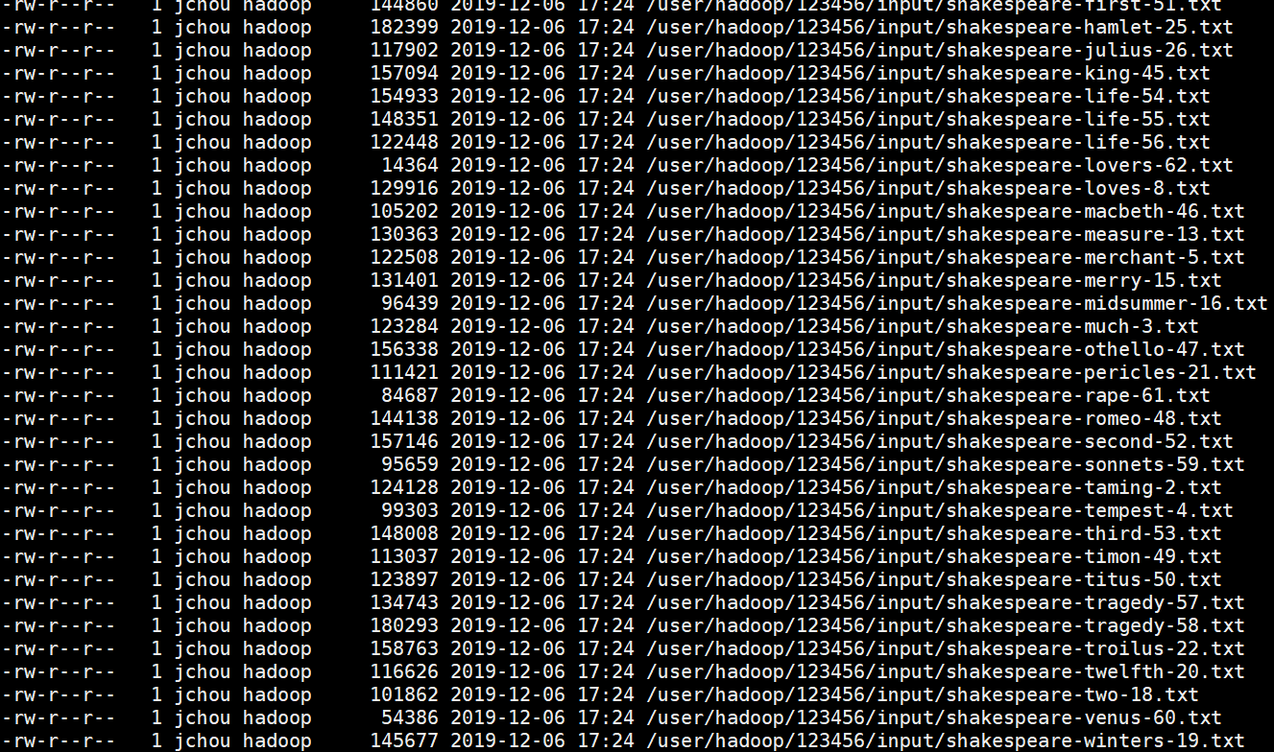
Steps to Prepare Input Files

Slide 28
Steps to Compile & Run Jobs
Compile the Hadoop java files
Create a jar file for the executable
Remove the output folder on HDFS
Run the Hadoop job
$ javac -classpath `hadoop classpath` WordCount.java -d bin
$ jar -cvf WordCount.jar -C bin .
$ hadoop fs -rm -R /user/hadoop/[username]/output
$ hadoop jar WordCount.jar org.myorg.WordCount /user/hadoop/[username]/input /user/hadoop/[username]/output

Slide 29
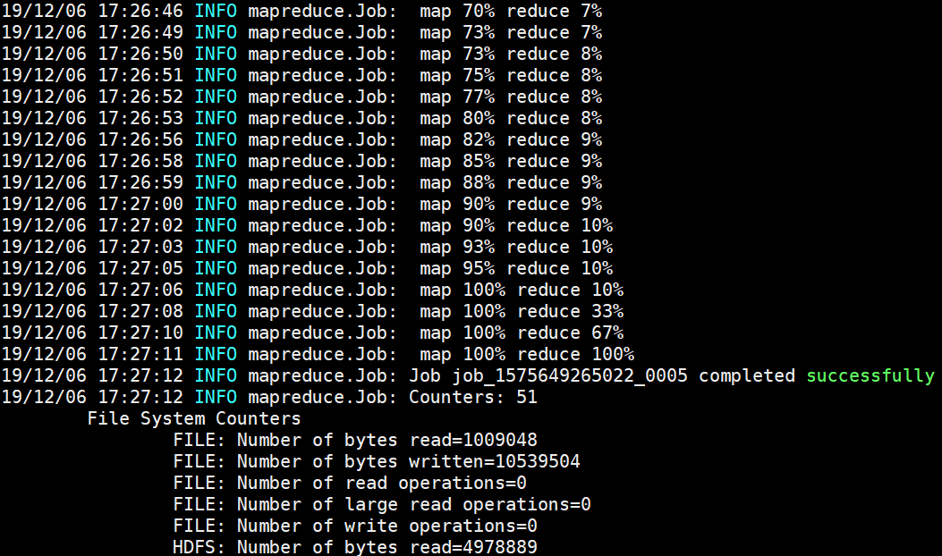
Steps to Compile & Run Jobs

Slide 30

Steps to Check Output Results
Show the content of the output files on HDFS
Merge & get the output files to local file system
Show the content of the output files to TA
$ hadoop fs -ls /user/hadoop/[username]/output
$ hadoop fs -cat /user/hadoop/[username]/output/part-r-00002
$ hadoop fs -getmerge /user/hadoop/[username]/output output.txt
$ tail output.txt

Slide 31
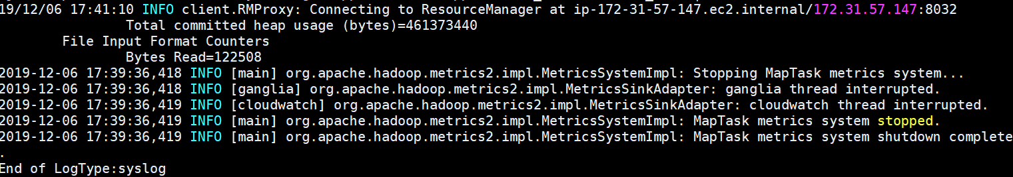
Hadoop Job Log
Dump output log:
Kill Hadoop job:
Get a list of all applications:
$ yarn logs -applicationId [your_app_ID]
$ yarn application -kill [your_app_ID]
$ yarn application -list

Slide 32
Hadoop Web UI
Cluster Hadoop Status
http://[Hadoop Master IP]:50070
MapReduce Job Tracker
http://[Hadoop Master IP]:8088
Job History Server
http://[Hadoop Master IP]:19888

Slide 33
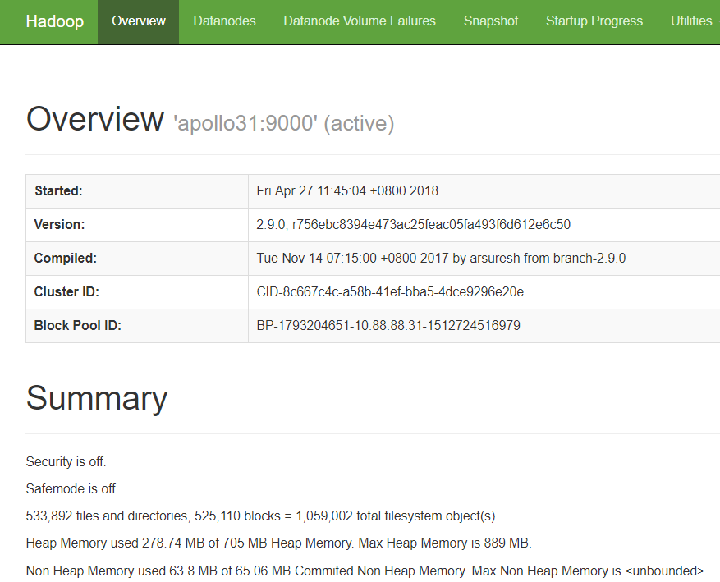
Cluster Hadoop Status
Browser HDFS on web console (port:50070)

Slide 34
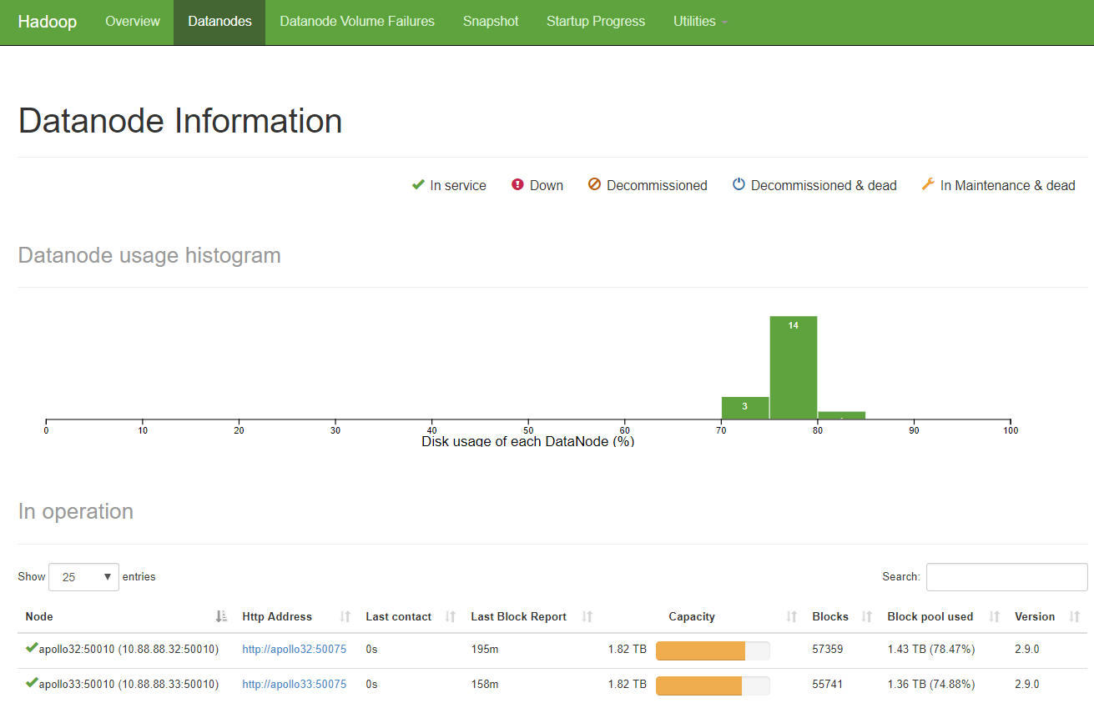
Cluster Hadoop Status
Browser HDFS on web console (port:50070)

Slide 35
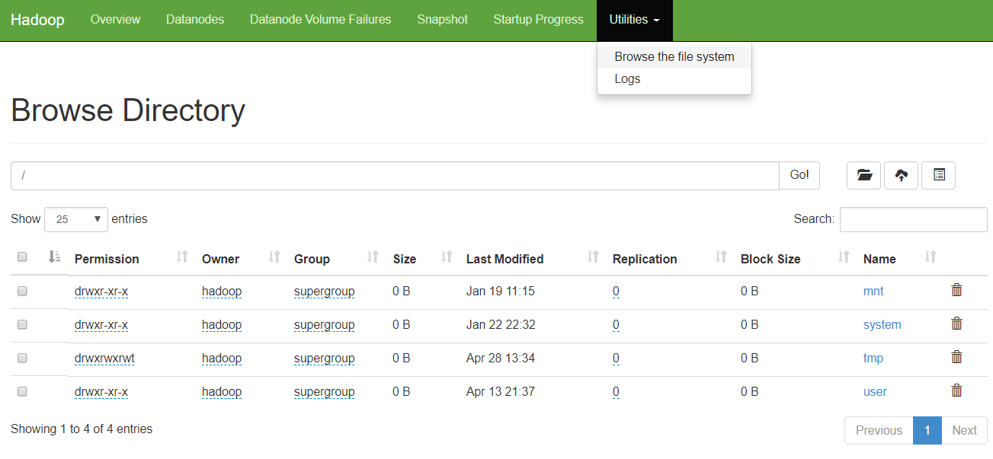
Cluster Hadoop Status
Browser HDFS on web console (port:50070)

Slide 36
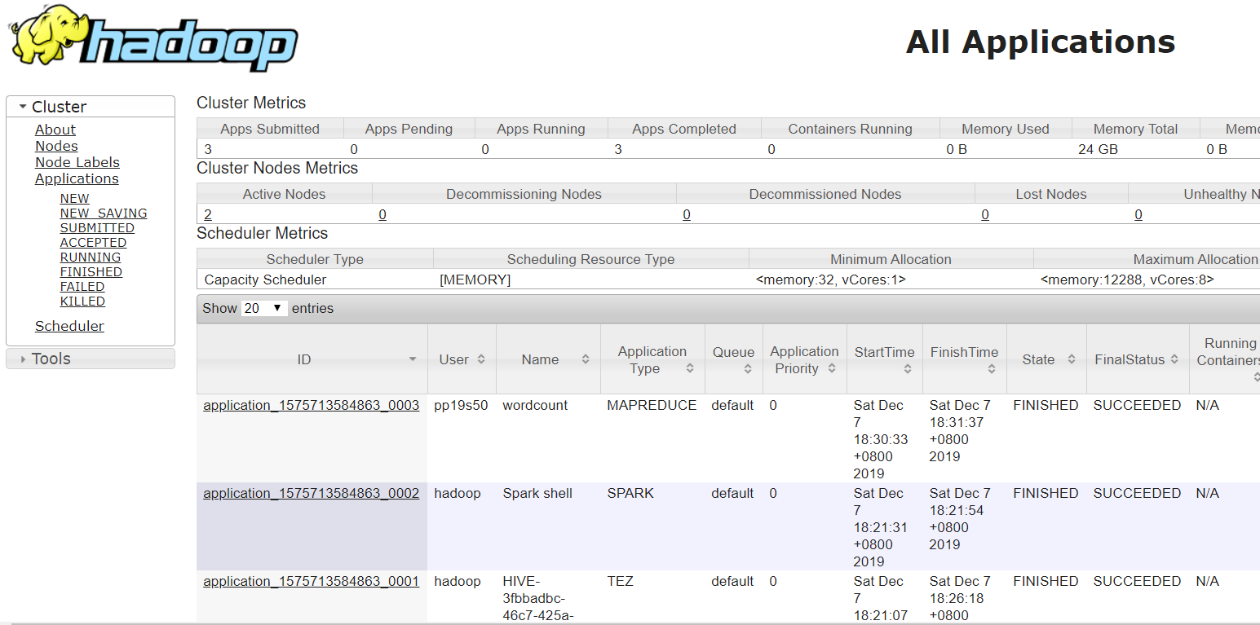
Job Tracker
Browser all the job execution status (port:8088)

Slide 37
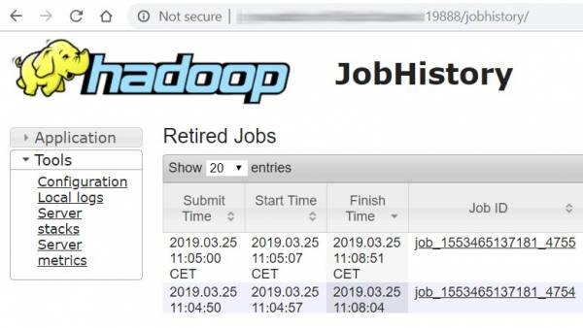
Job History Server
Browser job history (port:19888)

Slide 38
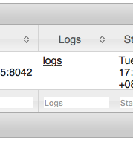
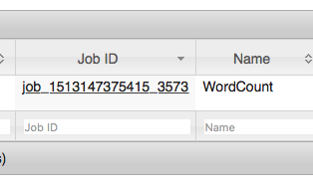
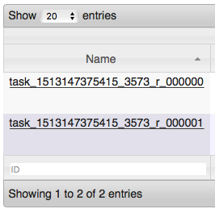
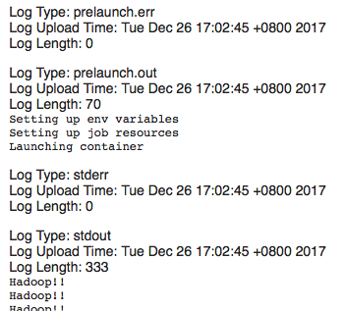
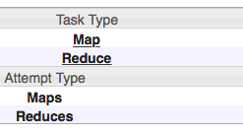
Job History Server
Check the log file in cluster mode
Access Job History Server
4
1
3
5
2

Slide 39
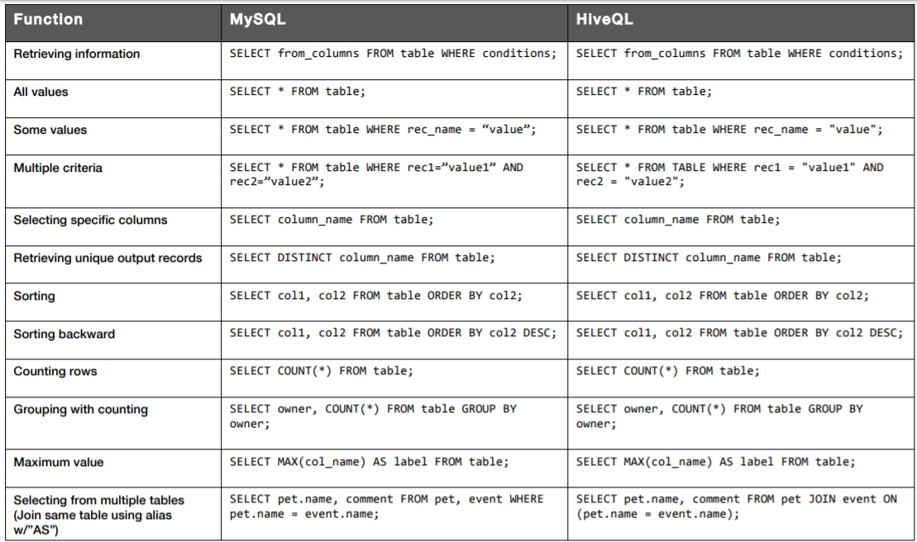
Cheat Sheet Hive for SQL Users
Complete reference: http://tw.gitbook.net/hive/index.html
http://hortonworks.com/wp-content/ uploads/2016/05/Hortonworks.CheatSheet.SQLtoHive.pdf

Slide 40
Hands-on Lab: Hive
Run in Hive SHELL
Create a database named by your studentID
Create a table named “exam” under your DB with the following schema: id(int), name(string), score(int)
Load data to the table from filepath ‘/home/hive/sample.txt’
Show all the content in table
$ hive
hive> CREATE DATABASE test_[username];
hive> CREATE TABLE test_[username].exam (id int, name string, score int) ROW FORMAT DELIMITED FIELDS TERMINATED BY '\t'
hive> LOAD DATA LOCAL INPATH '/home/[username]/lab7/hive/sample.txt' OVERWRITE INTO TABLE test_[username].exam;
hive> SELECT * from test_[username].exam;

Slide 41
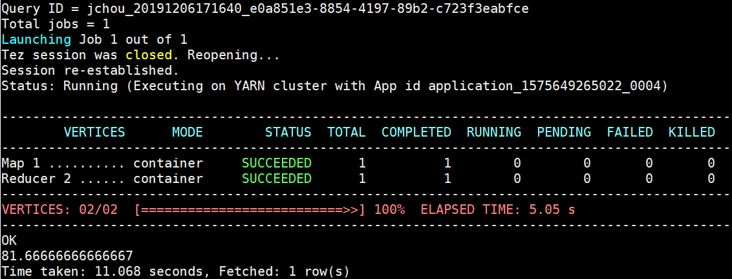
Hands-on Lab: Hive
Compute the average score from the table
hive> SELECT avg(score) from test_[username].exam;

Slide 42
Hands-on Lab
SSH login to our Spark cluster
Access info has just sent to your ilms email

Slide 43
Steps to Prepare Input Files
Copy files to your home directory & switch to the dir
Create your own folder on HDFS:
Copy input test files from local file system to your HDFS
Show the content of the input file on HDFS
$ cp -R /home/hadoop/WordCount .
$ cd WordCount
$ hadoop fs -mkdir /user/spark/[username]
$ hadoop fs -put input /user/spark/[username]/
$ hadoop fs -cat /user/spark/[username]/input/hello.dat

Slide 44
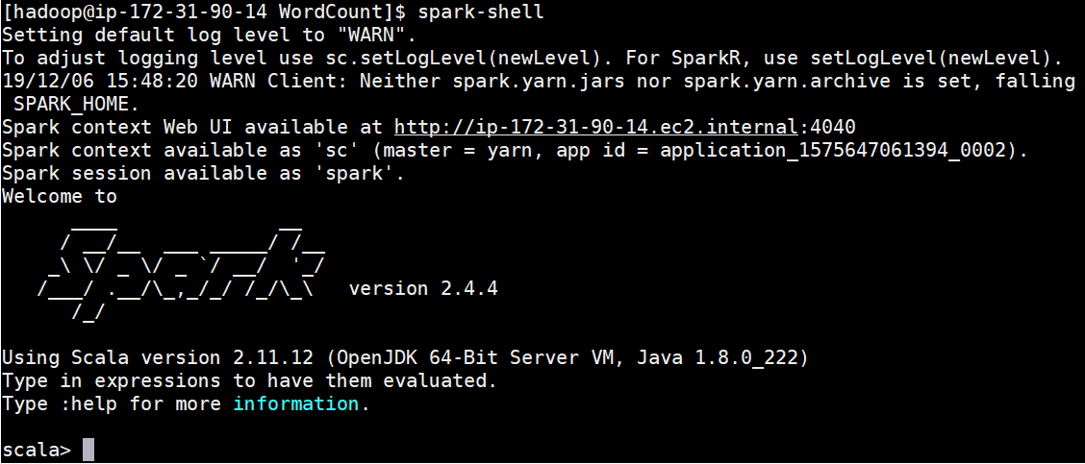
Hands-on Lab: Spark
spark-shell
Show your output result
Spark can also be written in Python and run on PySpark
Reference: https://spark.apache.org/examples.html

Slide 45
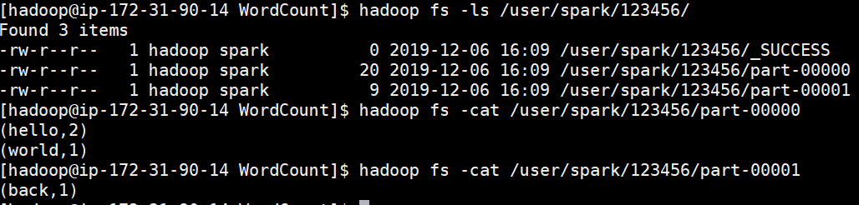
Hands-on Lab: Spark
Type WordCount scala code line-by-line in Spark Shell
Show your output result
val textFile = sc.textFile("/user/hadoop/[username]/input/hello.dat")
val counts = textFile.flatMap(line => line.split(" ")) .map(word => (word, 1)) .reduceByKey(_ + _)
counts.saveAsTextFile("/user/spark/[username]")

Slide 46
Spark Examples
HDFS location
WordCount
Pi Estimation
val textFile = sc.textFile(“<input_directory_path>”)
val counts = textFile.flatMap(line => line.split(" ")) .map(word => (word, 1)) .reduceByKey(_ + _)
counts.saveAsTextFile("<input_directory_path>")
val count = sc.parallelize(1 to NUM_SAMPLES).filter { _ =>
val x = math.random
val y = math.random x*x + y*y < 1 }.count()
println(s"Pi is roughly ${4.0 * count / NUM_SAMPLES}")

Slide 47
Spark Examples
Prediction with Logistic Regression
// Every record of this DataFrame contains the label and
// features represented by a vector.
val df = sqlContext.createDataFrame(data).toDF("label", "features")
// Set parameters for the algorithm.
// Here, we limit the number of iterations to 10.
val lr = new LogisticRegression().setMaxIter(10)
// Fit the model to the data.
val model = lr.fit(df)
// Inspect the model: get the feature weights.
val weights = model.weights
// Given a dataset, predict each point's label, and show the results.
model.transform(df).show()

Slide 48
Advanced Prog.
Custom key & value types
Combiner
Partitioner
GroupingComparator
SortComparator

Slide 49
Custom Value Types
Value in 3-dimensional coordinate
struct point3d { float x; float y; float z; }
Implement Writable interface
write: data serialization
readFields: data de-serialization
public class Point3D implements Writable {
private float x; private float y; private float z;
public Point3D(float x, float y, float z) { this.x = x; this.y = y; this.z = z; }
public void write(DataOutput out) throws IOException {
out.writeFloat(x); out.writeFloat(y); out.writeFloat(z);
}
public void readFields(DataInput in) throws IOException
{ x = in.readFloat(); y = in.readFloat(); z = in.readFloat(); }
}

Slide 50
Custom Key Types
Key in 3-dimensional coordinate
struct point3d { float x; float y; float z; }
Implement all functions in the writable interface
write(), readFields()
Implement additional functions in the writablecomparable interface
compareTo(): used for sorting
Compares this object with the specified object for order. Returns a negative integer, zero, or a positive integer as this object is less than, equal to, or greater than the specified object.
hashCode(): used for partitioning

Slide 51
Custom Key Types
public class Point3D implements WritableComparable <Point3D> {
private float x; private float y; private float z;
public 3DPoint (){x=0.0f; y=0.0f; z=0.0f;}
public void set(float x, float y, float z) { this.x = x; this.y = y; this.z = z; }
public float distanceFromOrigin() {
return (float)Math.sqrt(x*x + y*y + z*z);
}
public int compareTo(Point3D other) {
float myDistance = distanceFromOrigin();
float otherDistance = other.distanceFromOrigin();
return Float.compare(myDistance, otherDistance);
}
public int hashCode() {
return Float.floatToIntBits(x) ^ Float.floatToIntBits(y) ^
Float.floatToIntBits(z);
}
// overwrite other methods in Writable interface: write & readFields
}

Slide 52
Use Case Example
Given a list of 3D-coordinates, sort them in order in each of the output file:
key type: Point3D
Value type: NullWritable
Mapper: map each line to {<x,y,z>, Null}
Reducer: write key to file
➔Data is sorted automatically by Key in the MapReduce process

Slide 53
Point3D Sorting Example
public class TestPoint3D {
public static class TokenizerMapper
extends Mapper<Object, Text, Point3D, NullWritable>
{
private Point3D point = new Point3D();
public void map(Object key, Text value, Context context
) throws IOException, InterruptedException {
String line = value.toString();
String[] tokens = line.split(",");
float x = Float.parseFloat(tokens[0]);
float y = Float.parseFloat(tokens[1]);
float z = Float.parseFloat(tokens[2]);
point.set(x,y,z);
context.write(point, NullWritable.get());
}
}
Input file:
0,0,0
1,0,2
4,4,4
2,2,2
Output file:
0,0,0
1,0,2
2,2,2
4,4,4
main():
job.setOutputKeyClass(Point3D.class);
job.setOutputValueClass(NullWritable.class);
job.setMapClass(Tokenizer.class);

Slide 54
Advanced Prog.
Custom key & value types
Combiner
Partitioner
GroupingComparator
SortComparator

Slide 55
Map Phase: Partitioner
Input fie
on HDFS
Local Memory/Buffer on each Mapper
Temp file
on local disk
dog cat dog deer
dog,1 cat ,1
dog ,1
deer,1
cat ,1
dog,1 dog ,1
dog cat dog deer pig bear
dog pig bear cat dog egg
cat ,1
dog,2
cat ,1
dog,2
deer,1
deer,1
deer,1
pig bear
dog pig
pig,1 bear,1
dog,1
pig,1
bear,1
dog,1
bear,1
dog,1
bear,1
dog,1
pig,1
pig,1
pig,2
pig,2
bear cat dog egg
bear,1 cat,1
dog,1
egg,1
bear,1 cat,1
dog,1
bear,1 cat,1
dog,1
bear,1 cat,1
dog,1
egg,1
egg,1
egg,1
split (inputformat)
map (mapper)
partition
(partitioner)
Combine
(combiner)
store

Slide 56
Map Phase: Partitioner
Partitioner decides which intermediate (K,V) pair is sent to which reducer
The total number of partitions is the same as the number of reduce tasks for the job.
Default partitioner: “HashPartitioner”
Write a custom Partitioner:
public class MyPartitioner implements Partitioner<Point3D, Writable> {
public int getPartition(Point3D key, Writable value, int numPart) {
return Math.abs(key.hashCode()) % numPart;
}
}
Total number of partitions
main(){
job.setPartitionerClass(MyPartitioner.class);
}

Slide 57
Map Phase: Combiner
Input fie
on HDFS
Local Memory/Buffer on each Mapper
Temp file
on local disk
dog cat dog deer
dog,1 cat ,1
dog ,1
deer,1
cat ,1
dog,1 dog ,1
dog cat dog deer pig bear
dog pig bear cat dog egg
cat ,1
dog,2
cat ,1
dog,2
deer,1
deer,1
deer,1
pig bear
dog pig
pig,1 bear,1
dog,1
pig,1
bear,1
dog,1
bear,1
dog,1
bear,1
dog,1
pig,1
pig,1
pig,2
pig,2
bear cat dog egg
bear,1 cat,1
dog,1
egg,1
bear,1 cat,1
dog,1
bear,1 cat,1
dog,1
bear,1 cat,1
dog,1
egg,1
egg,1
egg,1
split (inputformat)
map (mapper)
partition
(partitioner)
Combine
(combiner)
store

Slide 58
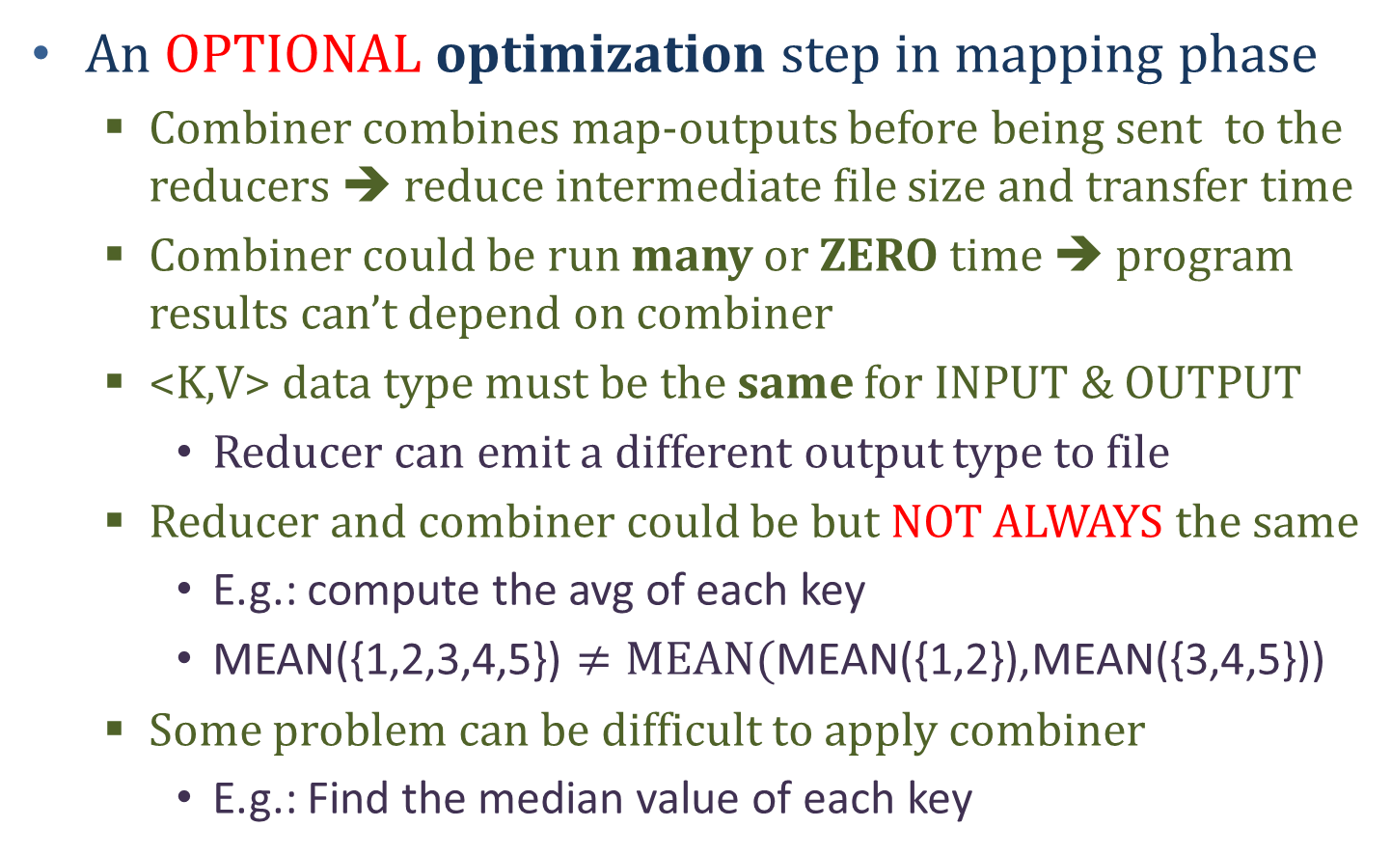
Map Phase: Combiner
An OPTIONAL optimization step in mapping phase
Combiner combines map-outputs before being sent to the reducers ➔ reduce intermediate file size and transfer time
Combiner could be run many or ZERO time ➔ program results can’t depend on combiner
<K,V> data type must be the same for INPUT & OUTPUT
Reducer can emit a different output type to file
Reducer and combiner could be but NOT ALWAYS the same
E.g.: compute the avg of each key
MEAN({1,2,3,4,5}) $≠\text{MEAN}\text{(}\text{MEAN}\text{(\{1,2\}),}\text{MEAN}\text{(\{3,4,5\}))}$
Some problem can be difficult to apply combiner
E.g.: Find the median value of each key

Slide 59
Advanced Prog.
Custom key & value types
Combiner
Partitioner
GroupingComparator
SortComparator

Slide 60
Reduce Phase: sortComparator
Temp file Mapper’s
local disk
Local Memory/Buffer on each Reducer
Output file
on HDFS
cat ,1
dog,2
cat ,1
dog,2
bear,1
bear,1 cat,1
cat,1
dog,1
dog,2
dog,1
deer,1
bear,1
dog,1
bear,<1,1>
cat,<1,1>
dog,<1,2,1>
bear,2
cat,2
dog,4
bear,2
cat,2
dog,4
bear,1
dog,1
bear,1 cat,1
dog,1
pig,2
bear,1 cat,1
dog,1
deer,1
deer,1
egg,1
pig,2
deer,<1>
egg,<1>
pig,<2>
deer,1
egg,1
pig,2
deer,1
egg,1
pig,2
pig,2
egg,1
egg,1
mergesort
(sortComparator)
group
(groupingComparator)
reduce
(reducer)
write
(outputformat)
fetch&shuffle

Slide 61
Reduce Phase: sortComparator
<K,V> pairs are sorted by key using a comparator class called the sortComparator
The comparator can be set by “job.setSortComparatorClass()”
The comparator must implement the “rawComparator” interface or extend “writeComparator” class
Override the function: compare
Implementation:
Mergesort is used by the framework to effectively merge the output from mappers, and sort the result in one stage

Slide 62
Reduce Phase: sortComparator
Let keys in the form of <string1>:<string2>
Sort keys in the ascending order of <string1>
public static class MySortComprator extends WritableComparator {
protected MySortComprator() { super(Text.class, true); }
public int compare(WritableComparable w1,
WritableComparable w2) {
Text t1 = (Text) w1;
Text t2 = (Text) w2;
String[] t1Items = t1.toString().split(":");
String[] t2Items = t2.toString().split(":");
return t1Items[0].compareTo(t2Items[0]);
}
}
main(){
job.setSortComparatorClass(MySortComparator.class);
}

Slide 63
Reduce Phase: groupingComparator
Temp file Mapper’s
local disk
Local Memory/Buffer on each Reducer
Output file
on HDFS
cat ,1
dog,2
cat ,1
dog,2
bear,1
bear,1 cat,1
cat,1
dog,1
dog,2
dog,1
deer,1
bear,1
dog,1
bear,<1,1>
cat,<1,1>
dog,<1,2,1>
bear,2
cat,2
dog,4
bear,2
cat,2
dog,4
bear,1
dog,1
bear,1 cat,1
dog,1
pig,2
bear,1 cat,1
dog,1
deer,1
deer,1
egg,1
pig,2
deer,<1>
egg,<1>
pig,<2>
deer,1
egg,1
pig,2
deer,1
egg,1
pig,2
pig,2
egg,1
egg,1
mergesort
(sortComparator)
group
(groupingComparator)
reduce
(reducer)
write
(outputformat)
fetch&shuffle

Slide 64
Reduce Phase: groupingComparator
<K,V> pairs are grouped together if their keys are compared as equal by using a comparator called groupingComparator
The comparator can be set by “job.setGroupingComparatorClass()”
The comparator must implement the “rawComparator” interface or extend “writeComparator” class
Override the function: compare
If multiple keys in the same group, “sortComparator” is used to decide the key for the group
Input: <A1, V1>, <A2, V2>, <A3, V3>, <B1, V4>, <B2, V5>
Grouping comparator to just compare the first letter
Output: (A1, {V1,V2,V3}); (B1, {V4,V5});

Slide 65
Reduce Phase: groupingComparator
Only compare the first letter
public static class MyGroupComp extends WritableComparator {
protected MyGroupCom() { super(Text.class, true); }
public int compare(WritableComparable w1, WritableComparable w2) {
Text t1 = (Text) w1; Text t2 = (Text) w2;
int t1char = t1.charAt(0); int t2char = t2.charAt(0);
if (t1char < t2char) return -1;
else if (t1char > t2char) return 1;
else return 0;
}
}
main(){
job.setGroupingComparatorClass(MyGroupComp.class);
}

Slide 66
Secondarysort example

Slide 67
SecondarySort
What is SecondarySort?
Sorting values associated with a key in the reduce phase
Examples:
Input: A dump of the temperature data with 4 columns
year, month, day, daily_temperature
Output: The temperature for every
year-month with the values sorted
in ascending order.
2012, 01, 01, 5
2012, 01, 02, 45
2012, 01, 03, 35
…
2001, 11, 01, 46
2001, 11, 02, 47
2001, 11, 03, 48
2012-01: 5, 35, 45
2001-11, 46, 47, 48
….

Slide 68
SecondarySort
Soltion1:
having the reducer buffer all of the values for a given key
then doing an in-reducer sort on the values
➔might cause the reducer to run out of memory
Solution2:
Trick MapReduce to sort the reducer values
Value-to-Key Conversion design pattern: “Creating a composite key by adding a part of, or the entire value to, the natural key to achieve your sorting objectives”
K1:yearMonth
K2:temperature
V:day
Natural key
Natural value
Composite key

Slide 69
SecondarySort
Implementation details:
Map Output Key: {yearMonth}+{temperature}
Map Output Value: temperature
Partitioner: by yearMonth
sortComparator: by yearMonth and then ascending temp.
groupingComparator: by yearMonth
2000,12,04,20
2000,11,01,30
2000,12,02,10
2000,11,01,10
2000,11,24,40
((2000-12,20), 20)
((2000-11,30), 30)
((2000-12,10), 10)
((2000-11,10), 10)
((2000-11,40), 40)
((2000-11,30), 30)
((2000-11,10), 10)
((2000-11,40), 40)
Shuffle & Sort
Map
Partition
((2000-12,20), 20)
((2000-12,20), 10)
Reduce
Group
((2000-11,10), 10)
((2000-11,30), 30)
((2000-11,40), 40)
2000-11, 10,30,40
2000-12, 10,20
((2000-11,10), [10,30,40])
((2000-12,20), [10,20])
((2000-12,20), 10)
((2000-12,20), 20)

Slide 70
Reference
Distributed system lecture slides from Gregory Kesden
Jeffrey Dean and Sanjay Ghemawat. MapReduce: Simplified Data Processing on Large Clusters. Proceedings of the 6th Symposium on Operating System Design and Implementation (OSDI 2004), pages 137-150
Hadoop tutorial:
https://hadoop.apache.org/docs/current/hadoop-mapreduce-client/hadoop-mapreduce-client-core/MapReduceTutorial.html

